Slide 1

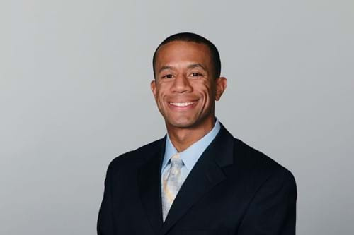
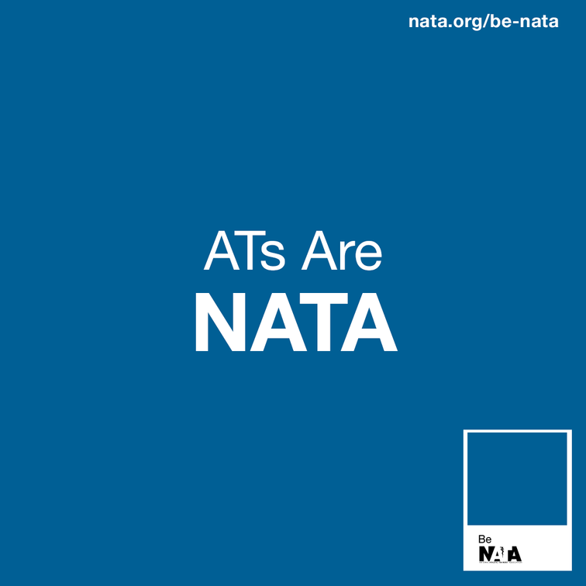



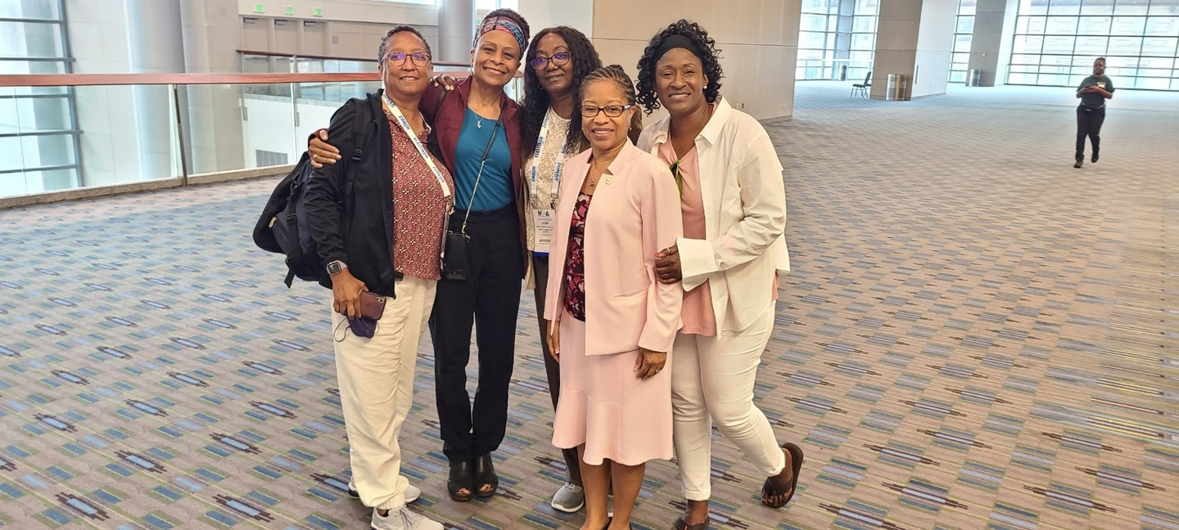
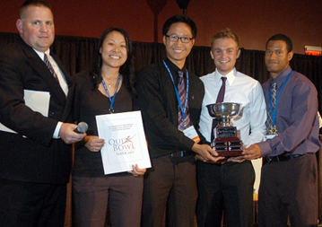
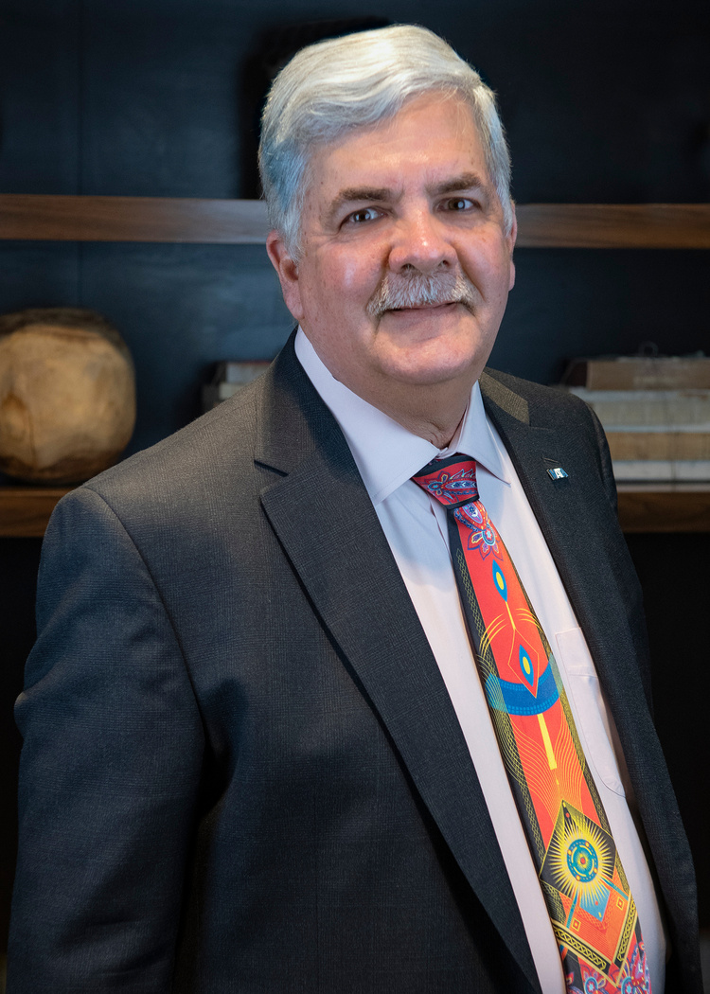
2025
BYLAWS
UPDATE

Slide 2



NATA
BYLAWS
UPDATE
The NATA is an inclusive organization that represents athletic trainers and wants all professional members to have a voice and the right to vote on membership matters.
The NATA prides itself on representation and advocacy for the athletic training profession, prioritizing our member-driven strategic plan and commitments, we welcome all perspectives within the profession.
The NATA is a membership organization rather than a credentialing body that recognizes state regulatory requirements are mandatory and legal for AT practice.

Slide 3





Each NATA District will be presenting this information and holding a vote for the various proposed bylaws changes during their respective district meetings.
Each district will then vote in accordance with their respective bylaws and other applicable voting rules, and any change approved by at least 2/3 of the total number of districts will be resubmitted to the Board, who will then approve changes by at least 2/3 vote, at which point the changes will go into effect.
If you have any questions about this process or about how to vote within your district, contact your District Director. (nata.org/board)
MEMBERSHIP
MEETINGS
COMMITTEES
OFFICERS
AMENDMENTS

Slide 4
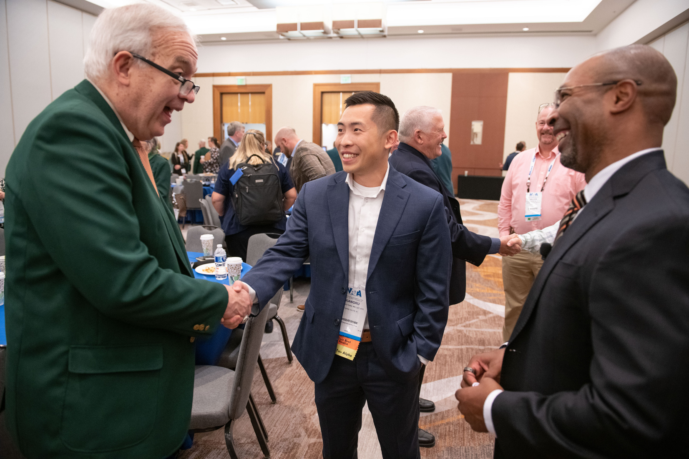
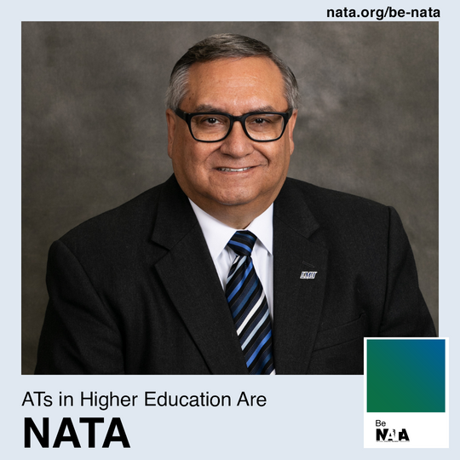
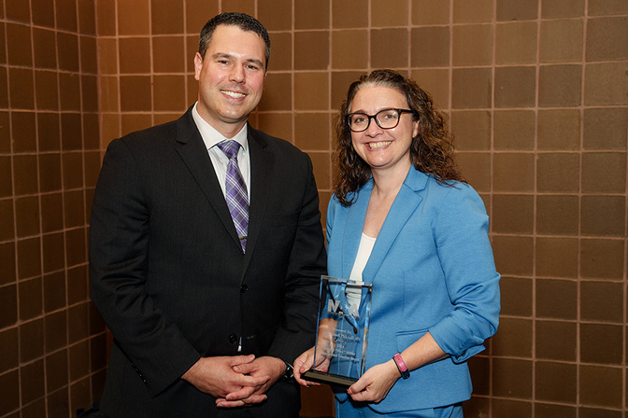

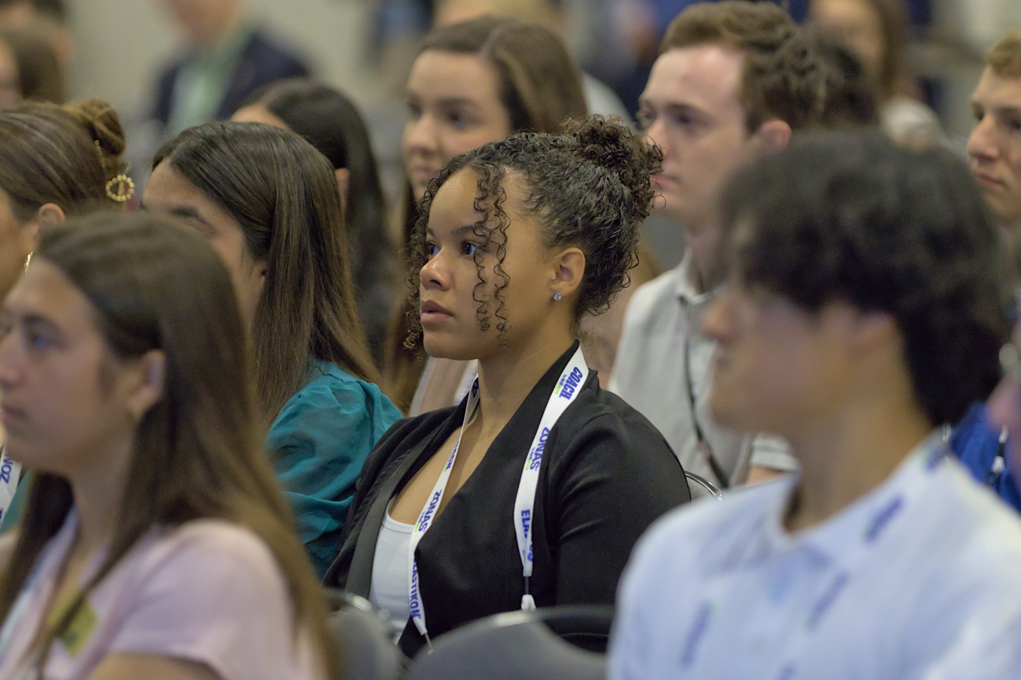




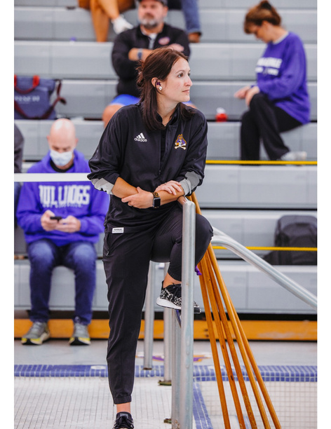
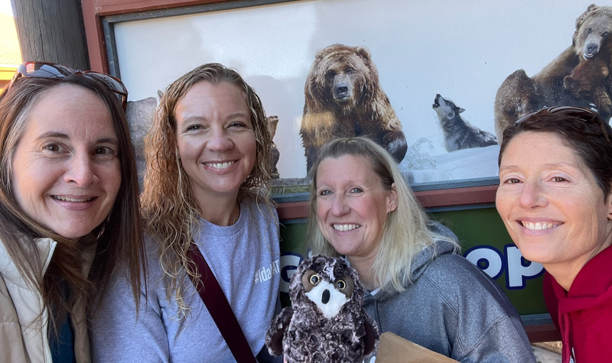
MEMBERSHIP CATEGORIES
RIGHTS AND PRIVILEGES
Motion 1: to approve Article 3.1 as written
Motion 2: to approve Article 3.4, 6.2, and 6.13 as written
MEMBERSHIP

Slide 5
ORIGINAL
3.1 Classes of Members. NATA shall have the following classes of Members. The Board of Directors may create categories within each class.
(a) Certified Members. Certified members possess current National Athletic Trainers’ Association Board of Certification, Inc. (BOC) certification (ATC) and are in good standing with the BOC.
(b) Certified-Retired Members. Certified-Retired Members have resigned certification with the BOC and met the Policies and Procedures Manual requirements for Certified-Retired status.
(c) Other Members. Individuals who do not possess BOC certification.

Slide 6
PROPOSED
3.1 Classes of Members. NATA shall have the following classes of Members. The Board of Directors may create categories within each class.
Professional Membership Categories: Individuals are eligible for Professional Membership if they meet one or more of the following qualifications:
i. Certified Members. Certified members possess current Board of Certification, Inc. (BOC) certification of Athletic Trainer Certified (ATC) and are in good standing with the BOC.
ii. Certified-Retired Members. Certified-Retired Members have resigned their ATC certification with the BOC and met the Policies and Procedures Manual requirements for Certified-Retired status.
iii. Licensed Only Members. Licensed members possess a current, valid license to practice athletic training in one or more U.S. states or territories, including the District of Columbia.
iv. Licensed Only-Retired Members. Licensed-Retired Members have retired their license(s) to practice athletic training in one or more U.S. states or territories, including the District of Columbia, and met the Policies and Procedures Manual requirements for Licensed-Retired status.
Other Membership Categories:
i. Other Members. Individuals who do not currently possess BOC certification or a state license to practice athletic training in one or more states or territories, including the District of Columbia.

Slide 7

RATIONALE
Motion 1: to approve Article 3.1 as written
·The NATA is an inclusive organization that represents athletic trainers and wants all professional members to have a voice and the right to vote on membership matters.
·The NATA prides itself on representation and advocacy for the athletic training profession, prioritizing our member-driven strategic plan and commitments, we welcome all perspectives within the profession
·The NATA is a membership organization rather than a credentialing body that recognizes state regulatory requirements are mandatory and legal for AT practice.
MEMBERSHIP

Slide 8
3.4 Membership Rights and Privileges.
(a) Certified Members. Each Certified Member shall have the right to one (1) vote on any matter coming before the Members and the right to attend the Annual Meeting and Clinical Symposia, the Annual Members’ Meeting, and other national meetings of NATA. Only Certified Members shall be eligible to serve as Directors and Officers of NATA. Certified Members may serve on Committees and as liaisons. Certified Members shall have the right to exercise such other privileges prescribed by the Board of Directors and set forth in these Bylaws and the Policies and Procedures Manual.
(b) Certified-Retired Members. Certified-Retired members shall have the right to one (1) vote on any matter coming before the Members and the right to attend the Annual Meeting and Clinical Symposia, the Annual Members’ Meeting, and other national meetings of NATA. Certified-Retired members shall pay no dues and have other rights and privileges prescribed by the Board of Directors and set forth in these Bylaws and the Policies and Procedures Manual.
(c) Other Members. Other Members shall have the right to attend the Annual Meeting and Clinical Symposia, the Annual Members’ Meeting, and other national meetings of NATA, but shall have no voting rights and shall not be eligible to serve as Directors or Officers of NATA. Such Members shall have other rights and privileges prescribed by the Board of Directors and set forth in these Bylaws and the Policies and Procedures Manual
ORIGINAL

Slide 9
3.4 Professional Membership Rights and Privileges.
(a) Professional Members. Each Certified and/or Licensed Member shall have the right to one (1) vote on any matter coming before the Members and the right to attend the Annual Meeting and Clinical Symposia, the Annual Members’ Meeting, and other national meetings of NATA. Professional Members shall be eligible to serve as Directors and Officers of NATA. Professional Members also may serve on Committees and as liaisons. Professional Members shall have the right to exercise such other privileges prescribed by the Board of Directors and set forth in these Bylaws and the Policies and Procedures Manual.
(b) Professional-Retired Members. Professional Certified-Retired and/or Licensed-Retired members shall have the right to one (1) vote on any matter coming before the Members and the right to attend the Annual Meeting and Clinical Symposia, the Annual Members’ Meeting, and other national meetings of NATA. Professional-Retired Members shall be eligible to serve as Directors and Officers of NATA. Professional-Retired Members may serve on Committees and as liaisons. Professional-Retired members shall pay no dues and have other rights and privileges prescribed by the Board of Directors and set forth in these Bylaws and the Policies and Procedures Manual.
Other Membership Rights and Privileges:
(c) Other Members. Other Members shall have the right to attend the Annual Meeting and Clinical Symposia, the Annual Members’ Meeting, and other national meetings of NATA, but shall have no voting rights and shall not be eligible to serve as Directors or Officers of NATA. Such Members shall have other rights and privileges prescribed by the Board of Directors and set forth in these Bylaws and the Policies and Procedures Manual.
PROPOSED
3.4 Professional Membership Rights and Privileges.
(a) Professional Members. Each Certified and/or Licensed Member shall have the right to one (1) vote on any matter coming before the Members and the right to attend the Annual Meeting and Clinical Symposia, the Annual Members’ Meeting, and other national meetings of NATA. Professional Members shall be eligible to serve as Directors and Officers of NATA. Professional Members also may serve on Committees and as liaisons. Professional Members shall have the right to exercise such other privileges prescribed by the Board of Directors and set forth in these Bylaws and the Policies and Procedures Manual.
(b) Professional-Retired Members. Professional Certified-Retired and/or Licensed-Retired members shall have the right to one (1) vote on any matter coming before the Members and the right to attend the Annual Meeting and Clinical Symposia, the Annual Members’ Meeting, and other national meetings of NATA. Professional-Retired Members shall be eligible to serve as Directors and Officers of NATA. Professional-Retired Members may serve on Committees and as liaisons. Professional-Retired members shall pay no dues and have other rights and privileges prescribed by the Board of Directors and set forth in these Bylaws and the Policies and Procedures Manual.
Other Membership Rights and Privileges:
(c) Other Members. Other Members shall have the right to attend the Annual Meeting and Clinical Symposia, the Annual Members’ Meeting, and other national meetings of NATA, but shall have no voting rights and shall not be eligible to serve as Directors or Officers of NATA. Such Members shall have other rights and privileges prescribed by the Board of Directors and set forth in these Bylaws and the Policies and Procedures Manual.
PROPOSED

Slide 10
ORIGINAL
6.2 Qualifications of Directors. Certified Members of NATA in good standing shall be eligible for election to the Board of Directors. A Director who ceases to meet the qualifications for Certified Member status shall automatically cease to be a Director. A Director who ceases to be a voting Member of the District that elected such Director shall automatically cease to be a Director except as provided in Section 5.2.
PROPOSED
6.2 Qualifications of Directors. Professional and Professional-Retired Members of NATA in good standing shall be eligible for election to the Board of Directors. A Director who ceases to meet the qualifications for Professional or Professional-Retired Member status shall automatically cease to be a Director. A Director who ceases to be a voting Member of the District that elected such Director shall automatically cease to be a Director except as provided in Section 5.2.

Slide 11
ORIGINAL
6.13 Action by Majority Vote; Proxy Voting. Each Director shall have one (1) vote, except that the President shall have only the voting rights described in Sections 9.1 and 12.2 of these Bylaws. An affirmative majority vote of eligible voting Directors at a meeting where a quorum is present shall constitute action by the Board of Directors. A Director may vote in person or by proxy executed in writing by the Director. No proxy shall be valid after one (1) month from the date of its execution. Each proxy shall be revocable unless expressly provided therein to be irrevocable and unless otherwise made irrevocable by law. Only Certified Members from the same District as the Director issuing the proxy may be named as proxies.
PROPOSED
6.13 Action by Majority Vote; Proxy Voting. Each Director shall have one (1) vote, except that the President shall have only the voting rights described in Sections 9.1 and 12.2 of these Bylaws. An affirmative majority vote of eligible voting Directors at a meeting where a quorum is present shall constitute action by the Board of Directors. A Director may vote in person or by proxy executed in writing by the Director. No proxy shall be valid after one (1) month from the date of its execution. Each proxy shall be revocable unless expressly provided therein to be irrevocable and unless otherwise made irrevocable by law. Only Professional or Professional-Retired Members from the same District as the Director issuing the proxy may be named as proxies.

Slide 12
RATIONALE
Motion 2: to approve Article 3.4, 6.2, and 6.13 as written
·To be more inclusive of all certified and licensed athletic trainers, this change provides both with the same level of membership rights and privileges. See additional rationale under Article 3.1.
MEMBERSHIP

Slide 13
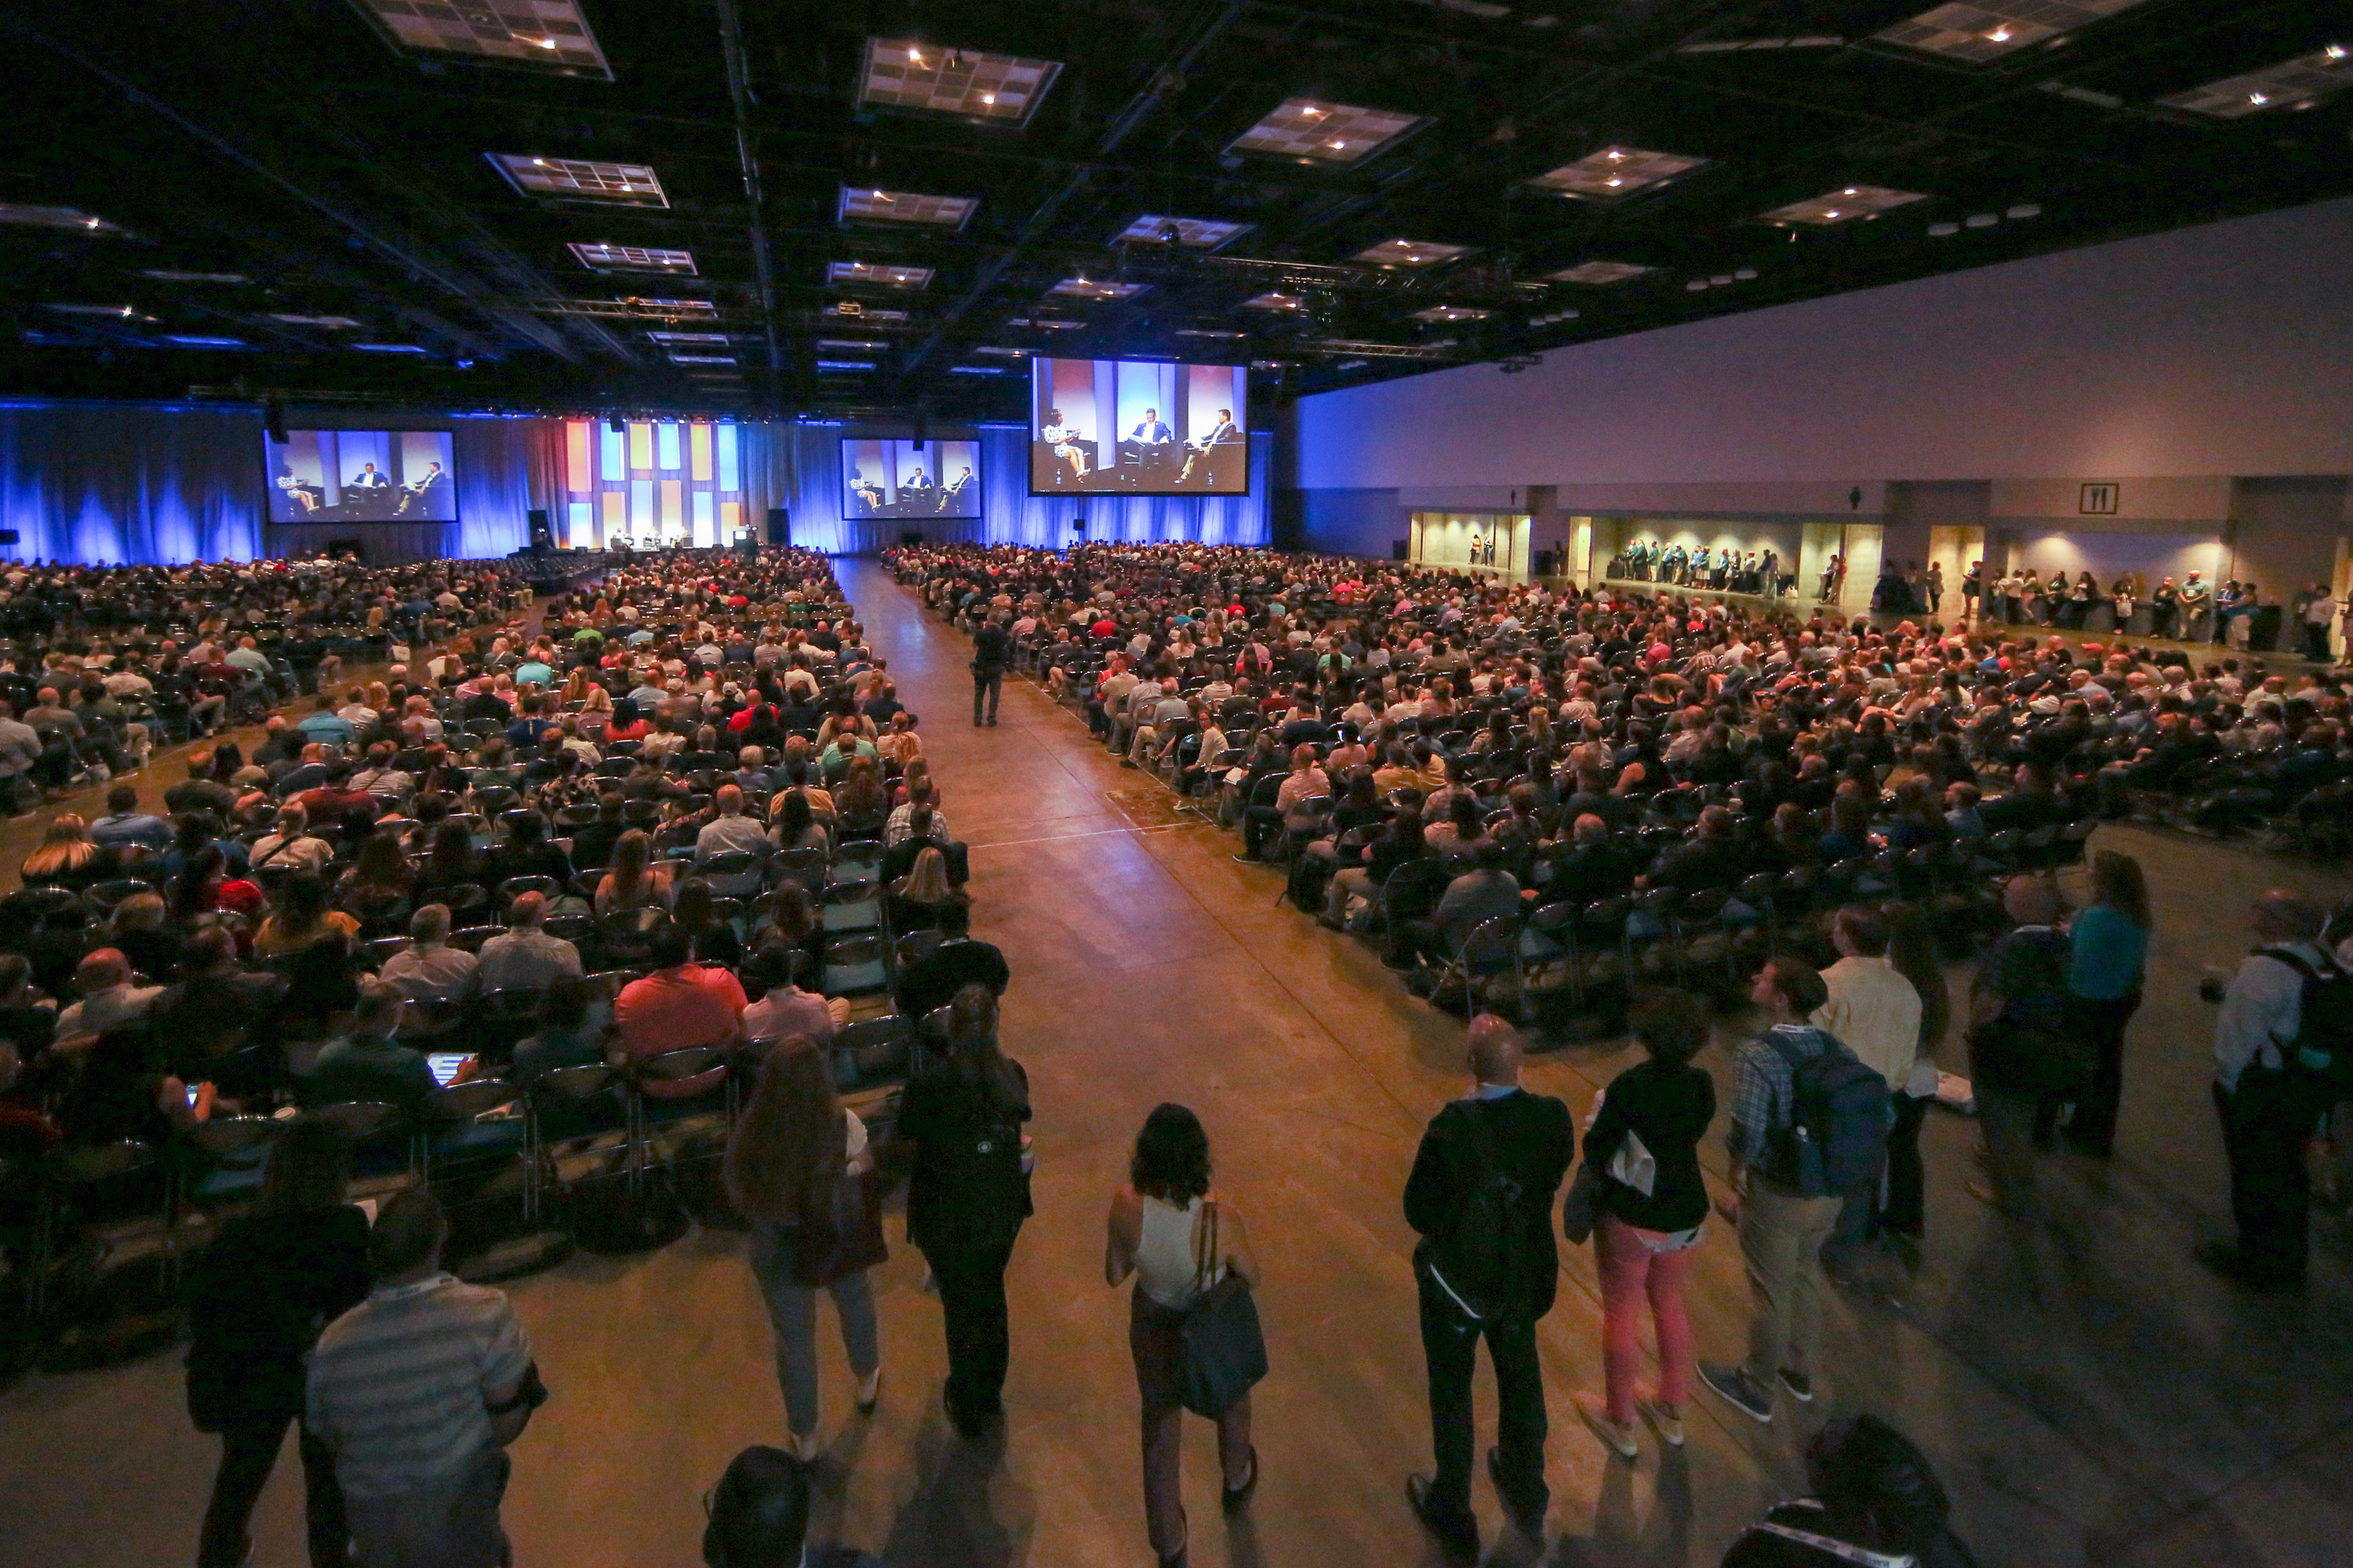
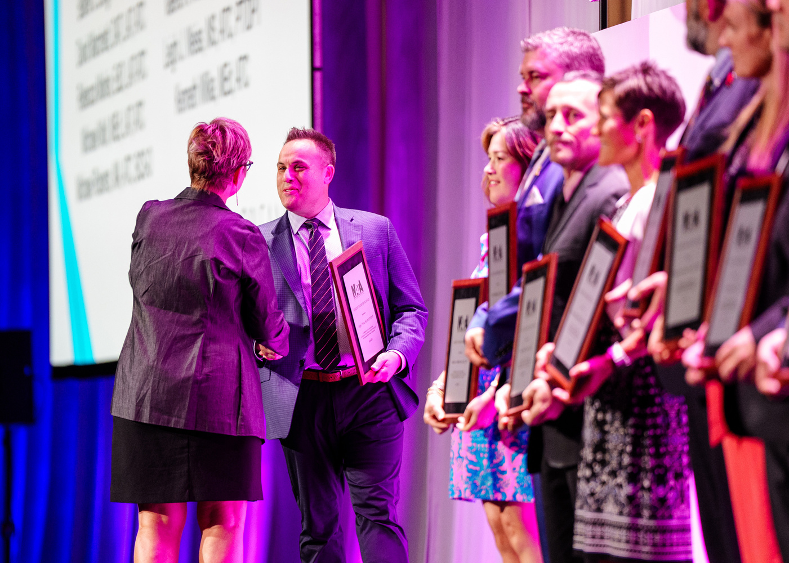
MEETINGS
Motion 3: to approve Article 4.1 as written
Motion 4: to approve Article 6.9 as written
Motion 5: to approve Article 6.10 as written
MEETINGS

Slide 14
ORIGINAL
4.1 Time, Location, Notification. An Annual Members’ Meeting of NATA shall be held in June. The location and time of the Annual Members’ Meeting shall be published in advance in appropriate NATA publications.
PROPOSED
4.1 Time, Location, Notification. A Members’ Meeting of NATA shall be held annually. Written notice of the Annual Members Meeting shall be given to all Members, stating the location, date, and time of the Annual Members’ Meeting. If the Annual Members’ Meeting will be held entirely or in part using videoconferencing technology, conference telephone, or another authorized electronic communications system, the form of communication to be used for the Annual Members’ Meeting and the means of accessing the communications system shall be included in the notice. Written notice shall be given to each Member personally, by first-class mail, or by electronic mail by not less than 10 days nor more than 60 days before the date of the Annual Member Meeting, to the Member’s address as appearing on the membership records of NATA.
RATIONALE
Motion 3: to approve Article 4.1 as written
  This gives the NATA the flexibility to hold the NATA Convention and its Annual Members’ Meeting in a month other than June if needed.
  Communication platforms have changed rapidly and will likely continue to do so.
  Additional clarifying language as required by Texas state law as advised by NATA’s legal counsel.
·To be more inclusive of all certified and licensed athletic trainers, this change provides both with the same level of membership rights and privileges. See additional rationale under Article 3.1.

Slide 15
ORIGINAL
6.9 Meetings. There shall be an Annual Meeting of the Board of Directors which shall be held in June. Other meetings of the Board of Directors may be called at any time by the President or at the request in writing of a majority of the number of Directors then in office. Minutes of all Board meetings shall be taken.
PROPOSED
6.9 Meetings. There shall be an Annual Meeting of the Board of Directors. Other meetings of the Board of Directors may be called at any time by the President or at the request in writing of a majority of the number of Directors then in office. Minutes of all Board meetings shall be taken.
RATIONALE
Motion 4: to approve Article 6.9 as written
Article 4.1 and 6.9 – Allows the meeting to be held in a month other than June and provides more flexibility for how the location and time of the meeting are communicated to members.
·To be more inclusive of all certified and licensed athletic trainers, this change provides both with the same level of membership rights and privileges. See additional rationale under Article 3.1.

Slide 16

ORIGINAL
6.10 Electronic Meetings. Members of the Board of Directors may convene using technology rather than an in person meeting as long as there is an audio component whereby participants can hear each other.
PROPOSED
6.10 Remote Meetings. Meetings of the Board of Directors, any committee designated by the Board of Directors, and meetings of the Members may be held entirely or in part using videoconference, conference telephone, or another authorized electronic communications system, as determined by the Board of Directors, as long as each person participating in the meeting can communicate with all other persons participating in the meeting, and provided that reasonable measures are used to sufficiently verify the identity of every person voting at the meeting using remote communications and to keep a record of any vote or other action taken. Participation by such means of remote communications shall constitute presence in person at a Meeting.
RATIONALE
Motion 5: to approve Article 6.10 as written
Revised to ensure that all participants in an electronic meeting can communicate with all other persons during the meeting. This change also allows for meetings to be held remotely.
·To be more inclusive of all certified and licensed athletic trainers, this change provides both with the same level of membership rights and privileges. See additional rationale under Article 3.1.

Slide 17
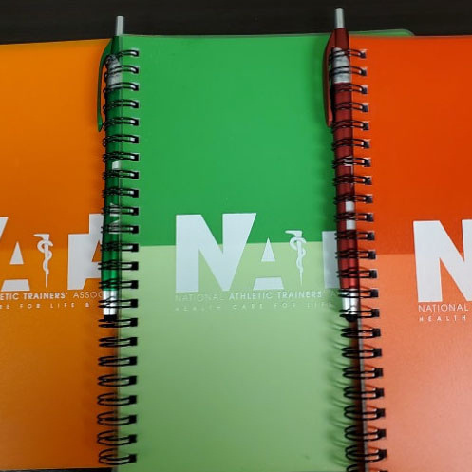

AMENDMENTS
Motion 6: to approve Article 12.1 as written
AMENDMENTS

Slide 18
ORIGINAL
PROPOSED
12.1 Substantive Changes. These Bylaws may be altered, amended, supplemented, or repealed after any such changes, proposed by the Board of Directors, are shared and presented virtually or in person with the membership at least 90 days in advance of any vote of the Districts’ membership to allow for feedback and comments prior to a vote of the eligible professional membership by district.After the membership has had at least 90 days to review the Bylaws revisions, each of NATA’s Districts shall vote on whether to approve the proposed revisions in accordance with each applicable District’s bylaws and other applicable rules for voting.Any changes approved by at least two thirds (2/3) of the total number of Districts shall be resubmitted to the Board of Directors. If the Board of Directors then approves the changes by at least a two-thirds (2/3) vote of the number of Directors then in office (excluding the President), the changes shall thereupon become effective.
12.1 Substantive Changes. These Bylaws may be altered, amended, supplemented, or repealed after any such changes, approved by the Board of Directors, are submitted to each of the Districts’ annual business meetings, and are approved by at least two-thirds (2/3) of the total number of Districts. Any changes so approved shall be resubmitted to the Board of Directors. If the Board of Directors then approves the changes by at least a two-thirds (2/3) vote of the number of Directors then in office (excluding the President), the changes shall thereupon become effective.
·To be more inclusive of all certified and licensed athletic trainers, this change provides both with the same level of membership rights and privileges. See additional rationale under Article 3.1.

Slide 19
EXPLANATION
Motion 6: to approve Article 12.1 as written
This would require any substantive changes to the NATA Bylaws to be shared with all members and then also presented to members either virtually or in person. It also now requires that any changes be shared with the membership at least 90 prior to a membership vote on the changes.
RATIONALE
Motion 6: to approve Article 12.1 as written
Not all members are able to attend district conferences in person, so this makes it easier for all members to attend the presentation and/or view a presentation recording later. It also clarifies that the vote would not occur in person including only those in attendance at the presentation, as the vote would be 90 days after the changes were shared with the membership. This would allow all members to vote on proposed bylaws changes rather than only those in attendance at the district conference.
AMENDMENTS

Slide 20




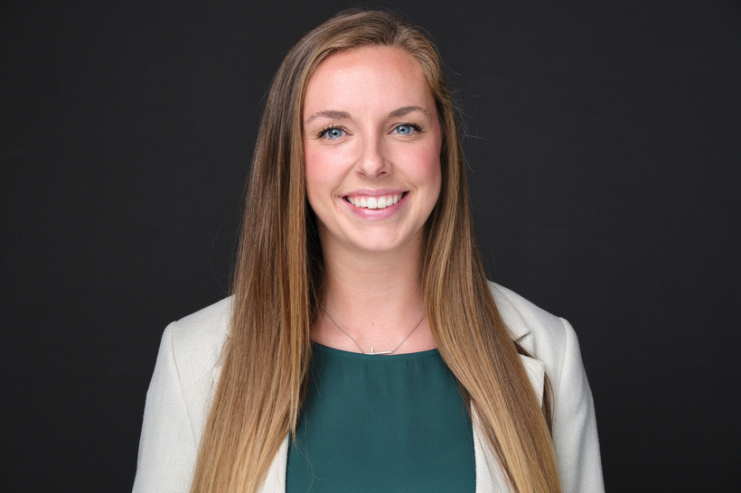

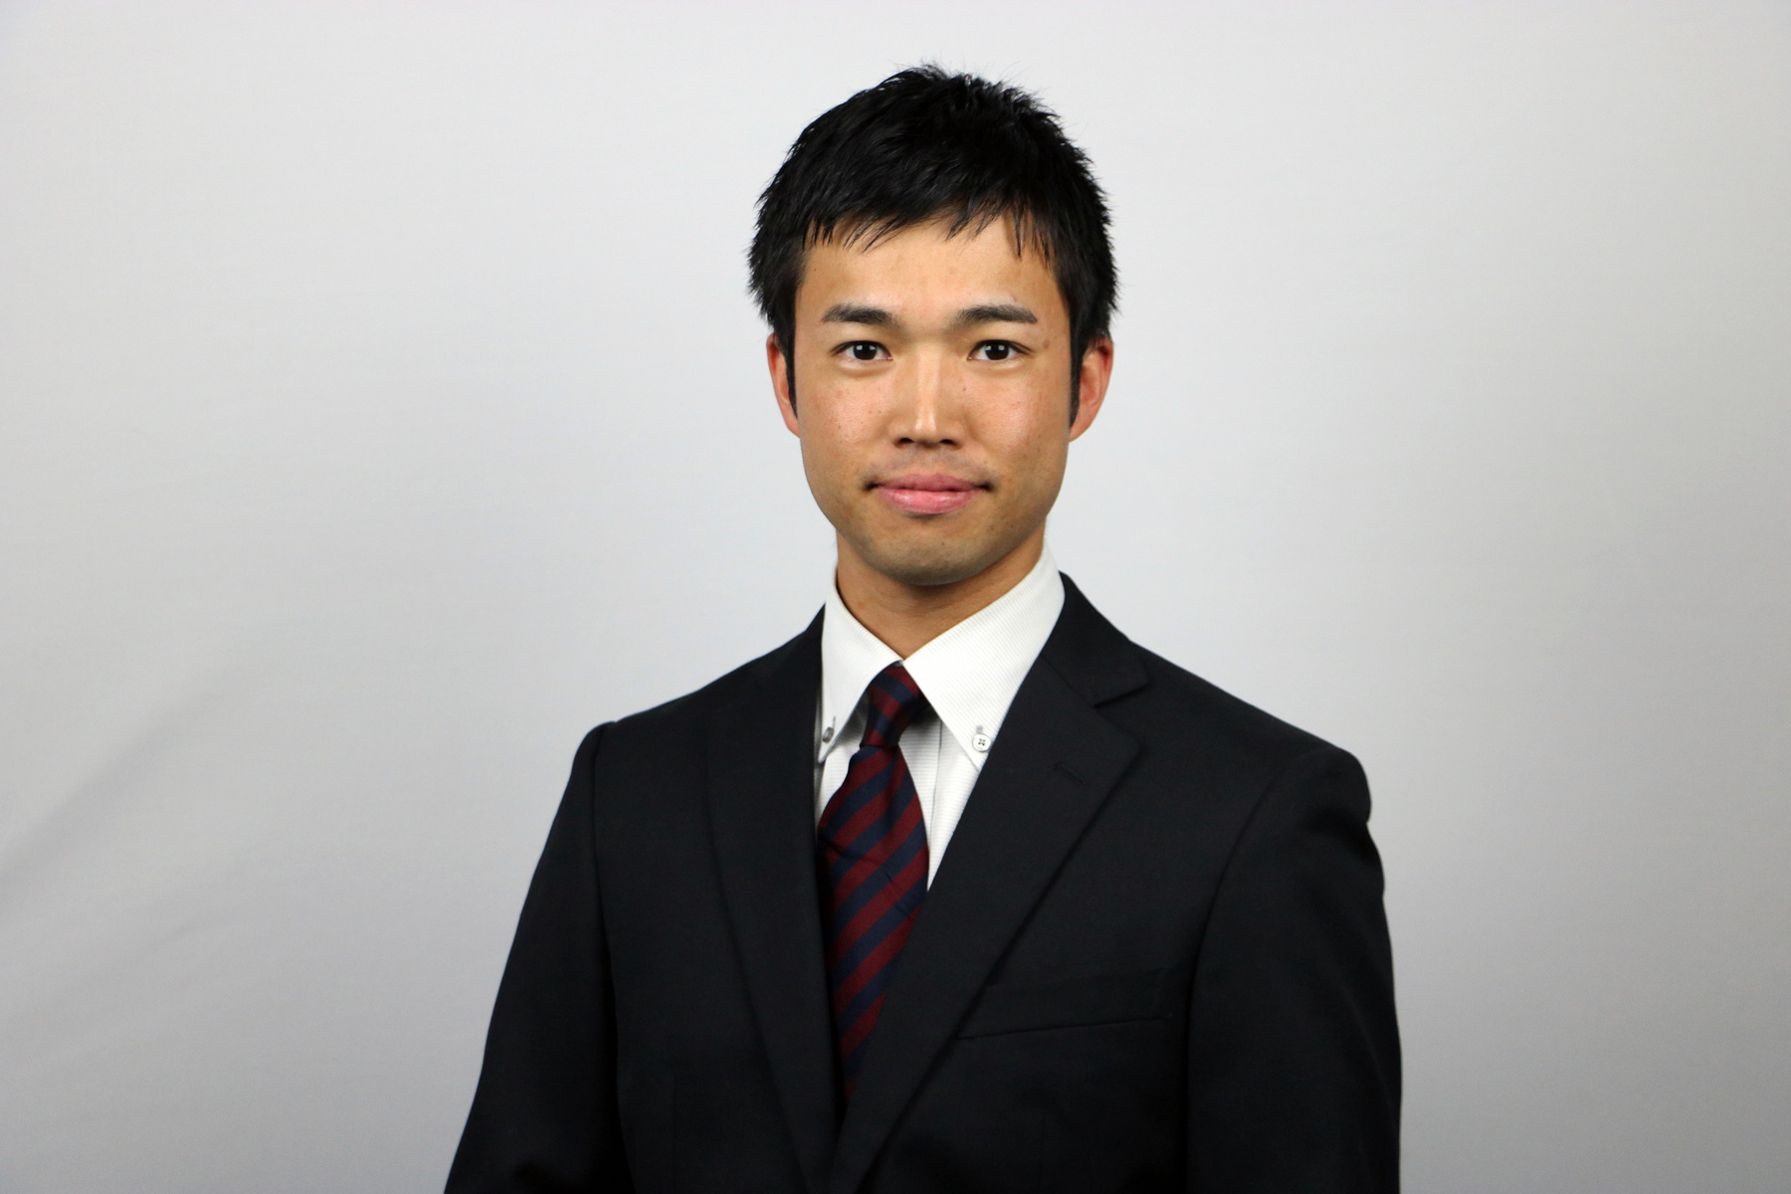
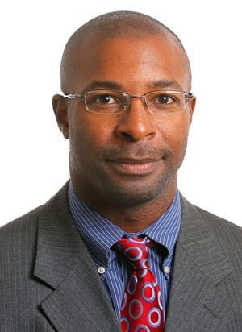

COMMITTEES
Motion 7: to approve Article 7.2 (a) as written
COMMITTEES

Slide 21
ORIGINAL
7.2 (a) Presidential Nominating Committee. The Presidential Nominating Committee is comprised of each seated District Director and the most immediate past Director for each district, provided they are currently a member of the district. Each district will receive one ballot per representative. In the event that one or both of these individuals is a candidate or unavailable, the District Board or equivalent will appoint a replacement(s) who will receive a proxy ballot. Those who declare candidacy shall not serve on the Nominating Committee and shall not vote .
PROPOSED
7.2 (a) Presidential Nominating Committee. The Presidential Nominating Committee is comprised of each seated District Director, the most immediate past Director for each District, provided they are currently a member of the District, and current NATA Board Committee/Council Chairs designated in the Presidential Election Policies and Procedures. Each Professional Member and Professional-Retired Member of the Presidential Nominating Committee will be permitted to vote. In the event that a NATA Board Committee/Council Chair is a candidate or unavailable, the Committee/Council will appoint a replacement who will receive a proxy ballot. Those who declare candidacy shall not serve on the Nominating Committee and shall not vote.

Slide 22
EXPLANATION
Motion 7: to approve Article 7.2 (a) as written
Expands the membership of the Presidential Nominating Committee to include all current NATA Committee and Council Chairs as designated by the Presidential Election Policies and Procedures Manual. If one of the Committee/Council Chairs, current District Director, or immediate past District Director has declared candidacy for President, this Article explains how a replacement will be appointed.
These changes include more individuals serving as voting members of the Presidential Nominating Committee. Note that the Chair of the Student Leadership Committee would always participate, but would only vote if they were a Professional Member who was certified and/or licensed as an athletic trainer.
RATIONALE
COMMITTEES
Motion7: to approve Article 7.2 (a) as written

Slide 23

OFFICERS
Motions 8 & 9: to approve Article 8.2 as written
Motion 10: to approve Article 8.5 (a) (b) as written
OFFICERS

Slide 24
ORIGINAL
8.2 President
(a) Nomination. If more than two (2) candidates choose to stand for election, the Presidential Nominating Committee shall (subject to qualifications contained in these bylaws) nominate two (2) candidates for President at a meeting to occur within one (1) year prior to the election of the President, which shall take place before the Annual Members’ Meeting at which the current President’s term ends. Each candidate must be a Certified Member, and must be a sitting Director or immediate past Director.

Slide 25
PROPOSED CHANGE Motion 8
8.2 President
(a) Nomination. If more than two (2) candidates choose to stand for election, the Presidential Nominating Committee shall (subject to qualifications contained in these bylaws) nominate two (2) candidates for President at a meeting to occur within one (1) year prior to the election of the President, which shall take place before the Annual Members’ Meeting at which the current President’s term ends. Each candidate must be a Certified Member or Certified-Retired Member. Candidates for the office of President must be a current or past NATA Committee or Council Chair who served under the current or immediate past-president or a current or past Director of NATA.
(b)Election. Elections shall be conducted in an orderly, efficient, equitable and secure manner. A ballot shall be sent to each Professional Member and Professional-Retired Member. An election shall not be held if there is only one candidate. The candidate receiving the largest number of votes shall take office as NATA’s President at the next Annual Members’ Meeting.
(c)Term of Office, Re-election. The term of office of the President shall be three (3) years. With the exception of a Vice President who advances to fill a partial term as President, the President may not serve more than one (1) term.

Slide 26
EXPLANATION
Motion 8: to approve Article 8.2 as written
This expands the pool of individuals who are eligible to run for the position of NATA President. It now includes all current and past District Directors (rather than only immediate past District Directors). It also now includes all current NATA Committee or Council Chairs and those Chairs who served under the current NATA president and the immediate past NATA President. All candidates for President also have to meet the eligibility requirements designated in the Presidential Election Policies and Procedures. This allows certified-retired members to be eligible to run for president if they meet all other requirements.
OFFICERS

Slide 27
PROPOSED CHANGE MOTION 9
8.2 President
(d) Nomination. If more than two (2) candidates choose to stand for election, the Presidential Nominating Committee shall (subject to qualifications contained in these bylaws) nominate two (2) candidates for President at a meeting to occur within one (1) year prior to the election of the President, which shall take place before the Annual Members’ Meeting at which the current President’s term ends. Each candidate must be a Professional Member or Professional-Retired Member. Candidates for the office of President must be a current or past NATA Committee or Council Chair who served under the current or immediate past-president or a current or past Director of NATA.
(e) Election. Elections shall be conducted in an orderly, efficient, equitable and secure manner. A ballot shall be sent to each Professional Member and Professional-Retired Member. An election shall not be held if there is only one candidate. The candidate receiving the largest number of votes shall take office as NATA’s President at the next Annual Members’ Meeting.
(f )Term of Office, Re-election. The term of office of the President shall be three (3) years. With the exception of a Vice President who advances to fill a partial term as President, the President may not serve more than one (1) term.

Slide 28
EXPLANATION
Motion 9: to approve Article 8.2 as written
This expands the pool of individuals who are eligible to run for the position of NATA President. It now includes all current and past District Directors (rather than only immediate past District Directors). It also now includes all current NATA Committee or Council Chairs and those Chairs who served under the current NATA president and the immediate past NATA President. All candidates for President also have to meet the eligibility requirements designated in the Presidential Election Policies and Procedures.
OFFICERS

Slide 29
RATIONALE
Motion 9: to approve Article 8.2 as written
This change allows more individuals to be eligible to run for NATA President.
OFFICERS
MEMBERSHIP

Slide 30
ORIGINAL
8.5 Vacancy, Resignation, and Removal
(a) Vacancy and Resignation.
i. Voluntary. An Officer may resign at any time by notifying the Board of Directors or the Executive Director in writing.
ii. Automatic. An Officer shall be deemed to have resigned and the Office shall be deemed to be vacant when such Officer: (A) resigns membership in NATA, (B) ceases to be a Certified Member in good standing of NATA, (C) dies, (D) ceases to be actively involved in the profession of athletic training, or (E) in the case of the Vice President, ceases to be a Director. If there is disagreement between an Officer and the Board of Directors with respect to whether one or more of these events has occurred, the Board shall decide the matter in the same manner as provided in Section 8.5 (b).
(b) Removal. An Officer may be removed by the Board of Directors under conditions set forth below. At an in-person meeting of the Board, the Officer whose removal is being considered will be given a full opportunity to discuss and respond. The Officer shall be removed if a four- fifths (4/5) vote of Directors not personally involved in the matter determines that one or both of the following has occurred: i. Conflict of Interest. The Officer has entered into a relationship that creates a significant conflict of interest with the goals of the NATA or the rights and obligations of the Office.
ii. Incompetence. The Officer is no longer able to fulfill the obligations of Office competently.

Slide 31
8.5 Vacancy, Resignation, and Removal
(a) Vacancy and Resignation.
i. Voluntary. An Officer may resign at any time by notifying the Board of Directors or the Executive Director in writing.
ii. Automatic. An Officer shall be deemed to have resigned and the Office shall be deemed to be vacant when such Officer: (A) resigns membership in NATA, (B) ceases to be a Certified Member and/or Licensed Member in good standing of NATA, (C) dies or becomes mentally or physically incapacitated, or (D) in the case of the Vice President or Secretary/Treasurer, ceases to be a Director. If there is disagreement between an Officer and the Board of Directors with respect to whether one or more of these events has occurred, the Board shall decide the matter in the same manner as provided in Section 8.5 (b).
(b) Removal. An Officer may be removed by the Board of Directors under conditions set forth below. At an in-person meeting of the Board, the Officer whose removal is being considered will be given a full opportunity to discuss and respond. The Officer shall be removed if a four-fifths (4/5) vote of Directors not personally involved in the matter determines that one or both of the following has occurred:
i. Conflict of Interest. The Officer has entered into a relationship that creates a significant conflict of interest with the goals of the NATA or the rights and obligations of the Office.
ii. Incompetence. The Officer is no longer able to fulfill the obligations of Office competently.
iii. Inappropriate Conduct. The Officer is found to have engaged in conduct that is illegal or unethical such that the Officer’s continued service would be contrary to the best interests of NATA.
PROPOSED CHANGE

Slide 32
EXPLANATION
Motion 10: to approve Article 8.5 (a) (b) as written
  If an officer of the NATA ceases to be actively involved in the profession of athletic training, this will no longer be cause for automatic removal from their position as an officer. (Note: The officers of the NATA include the President, Vice-President, and Secretary/Treasurer.) Their position would need to be reviewed by the board.
  Clarified that both the Vice-President and Secretary/Treasurer must both remain District Directors in order to remain in these officer roles.
  Added iii. Inappropriate conduct bullet as advised by NATA’s legal counsel.
OFFICERS
MEMBERSHIP

Slide 33
RATIONALE
Motion 10: to approve Article 8.5 (a) (b) as written
  Advised by NATA’s legal counsel: It is very difficult to define what is meant by “actively involved in the profession of athletic training.” The statement is ambiguous and was removed so as not to exclude an athletic trainer from NATA officer positions who moves from a clinical role to a leadership or other non-clinical role.
  Inappropriate conduct bullet allows for the removal of officers that have committed violations.
OFFICERS

Slide 34

THANK YOU
FOR YOUR ATTENTION
We appreciate your interest in making our profession the best it can possibly be.
nata.org

